Slide 1
Kirksville Grocery Store Database Website
Hunter Bowman and Sean Moen

Slide 2
Goals of the Project
Suppose you were planning a grocery trip and wanted to find where you should go for the cheapest prices.
A website to compare prices would be helpful.
We decided to collect prices of various items from Walmart, HyVee, and Aldi and create a website to display them.
The website can be updated by users.

Slide 3
Grocery Database Implementation
Webpages
Select a Grocery Store
View a Grocery Store and make changes
Add/Edit/Remove Items
Confirmation Pages

Slide 4
Technology Used
Database: MySQL
Programming Languages: HTML/CSS and PHP
Server: Apache XAMPP

Slide 5
Live Demo

Slide 6
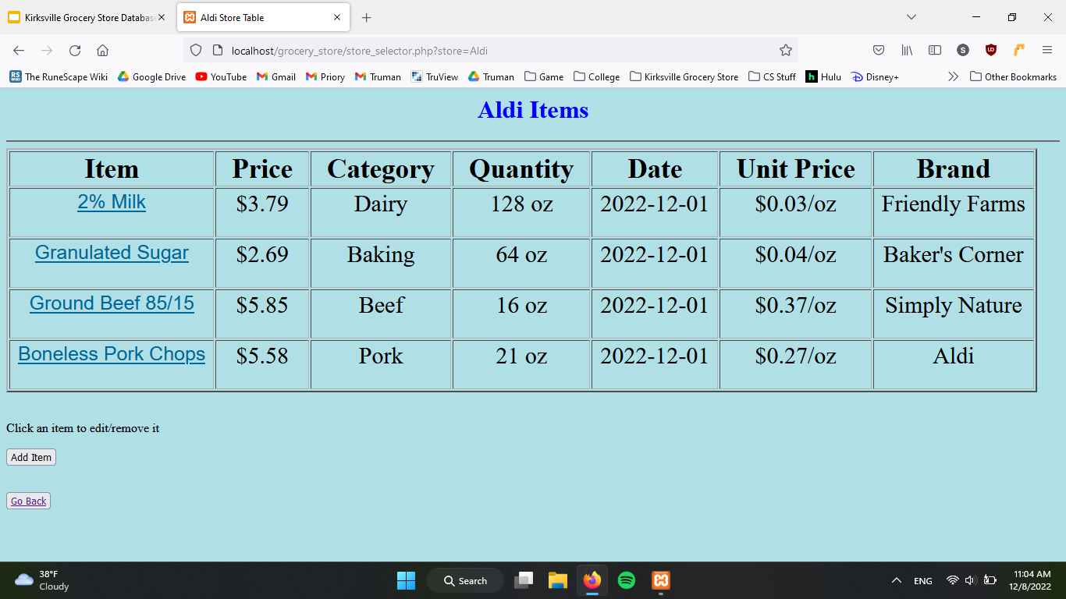
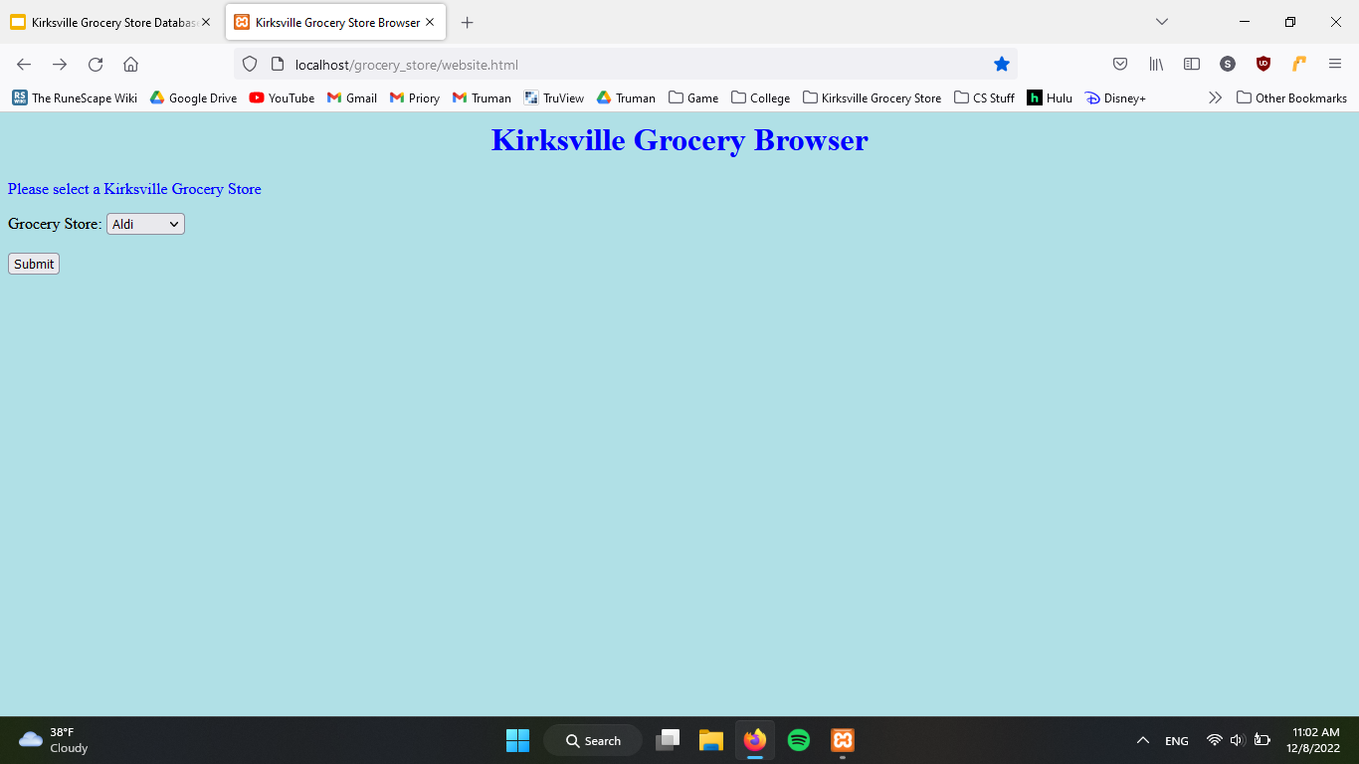
Homepage
Drop down menu to select grocery store
Click submit to go to the grocery store’s page

Slide 7
Store Table
Table display of all entries
Click an entry to edit or remove it
Buttons to add an entry or to go back to homepage

Slide 8
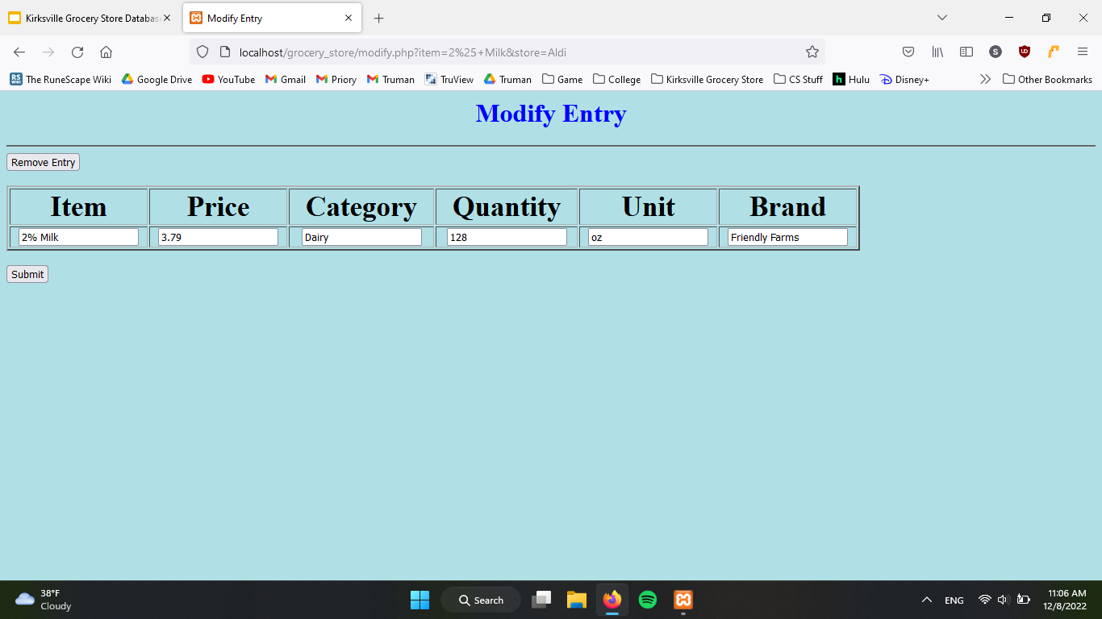
Edit/Delete Entry
Can edit an entry or remove it
Values are automatically filled with previous values
Date and Unit Price are automatically calculated

Slide 9
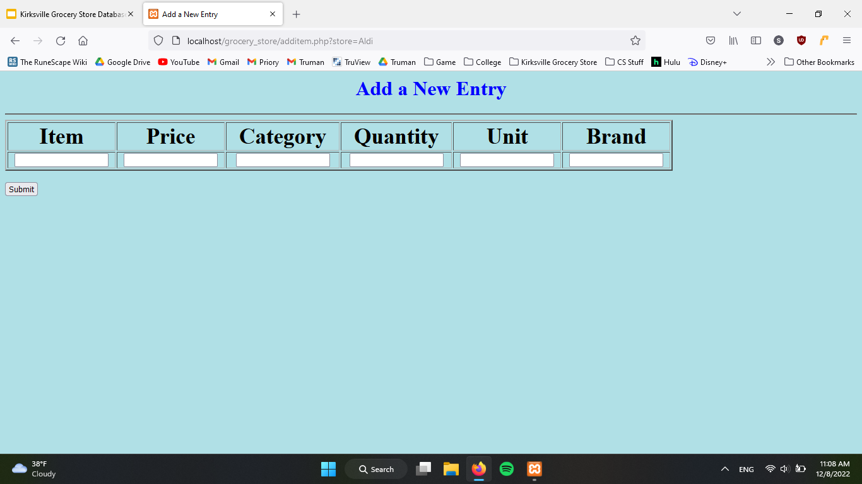
Add Entry
Similar to the edit page
Enter the values to create an entry

Slide 10
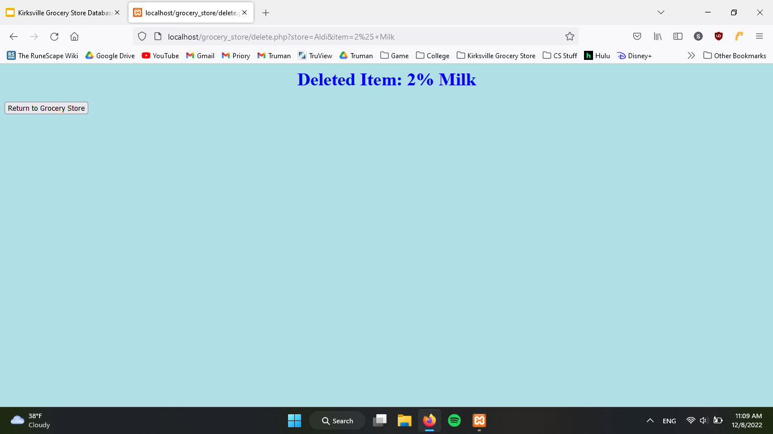
Result Page
Shown after adding, editing, or deleting a value
Shows item that has been changed
Button to return to the store’s table

Slide 11
Challenges
Our first time doing web development
Lots of time figuring out how to do stuff
Had to cut features: notably JavaScript for interaction

Slide 12
Possible Improvements
Given a user-inputted grocery list, calculate the store which has the cheapest overall price.
Ability to compare an individual item between stores.
E.g What store has the lowest price for milk?
Allow for sorting of data in a table by Date/Price/etc.
Automate data input by implementing a web scraper.
Would make website useful as data no longer would have to be manually entered.
Security - Perform input validation & sanitization
Parameterized statements
Principle of Least Privilege
Notes:
SQL statements are constructed before the driver is invoked, leaving it vulnerable to maliciously crafted parameters.

Slide 13
Questions?

